Slide 1



CVE Executive Report PPT
View in Power BI
Last data refresh:
8/6/2026 7:17:31 PM UTC
Downloaded at:
8/6/2026 7:21:34 PM UTC

Slide 2
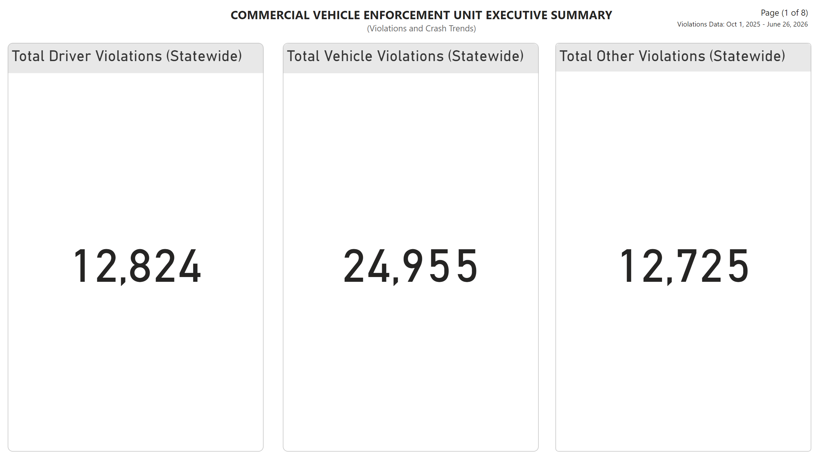
Page 1 - Total Violations
Notes:
FedOOSctch
No alt text provided
Total Driver Violations (Statewide)
No alt text provided
FedOOSctch
No alt text provided
textbox
No alt text provided
textbox
No alt text provided
Total Other Violations (Statewide)
No alt text provided
Total Vehicle Violations (Statewide)
No alt text provided
FedOOSctch
No alt text provided
textbox
No alt text provided

Slide 3
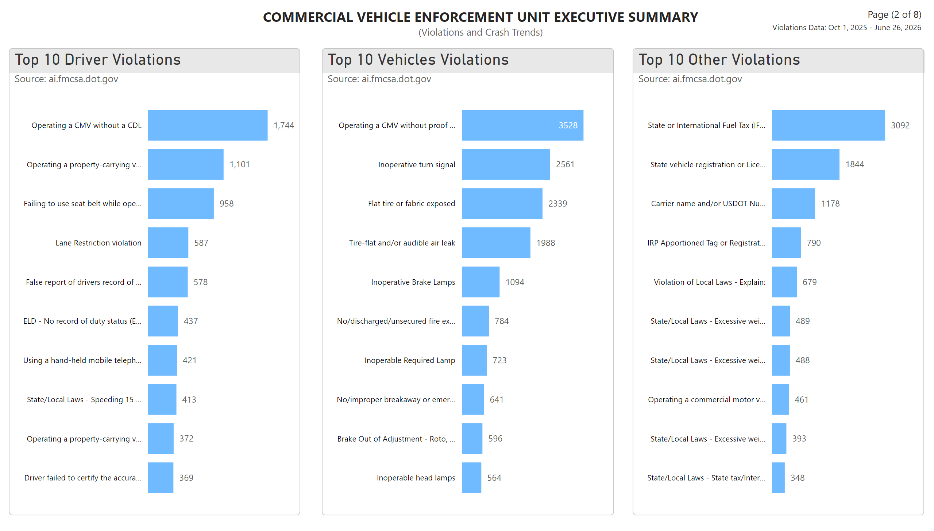
Page 2 - Violations
Notes:
data header
No alt text provided
Top 10 Driver Violations
No alt text provided
Top 10 Other Violations
No alt text provided
textbox
No alt text provided
textbox
No alt text provided
data header
No alt text provided
Top 10 Vehicles Violations
No alt text provided
textbox
No alt text provided
data header
No alt text provided

Slide 4
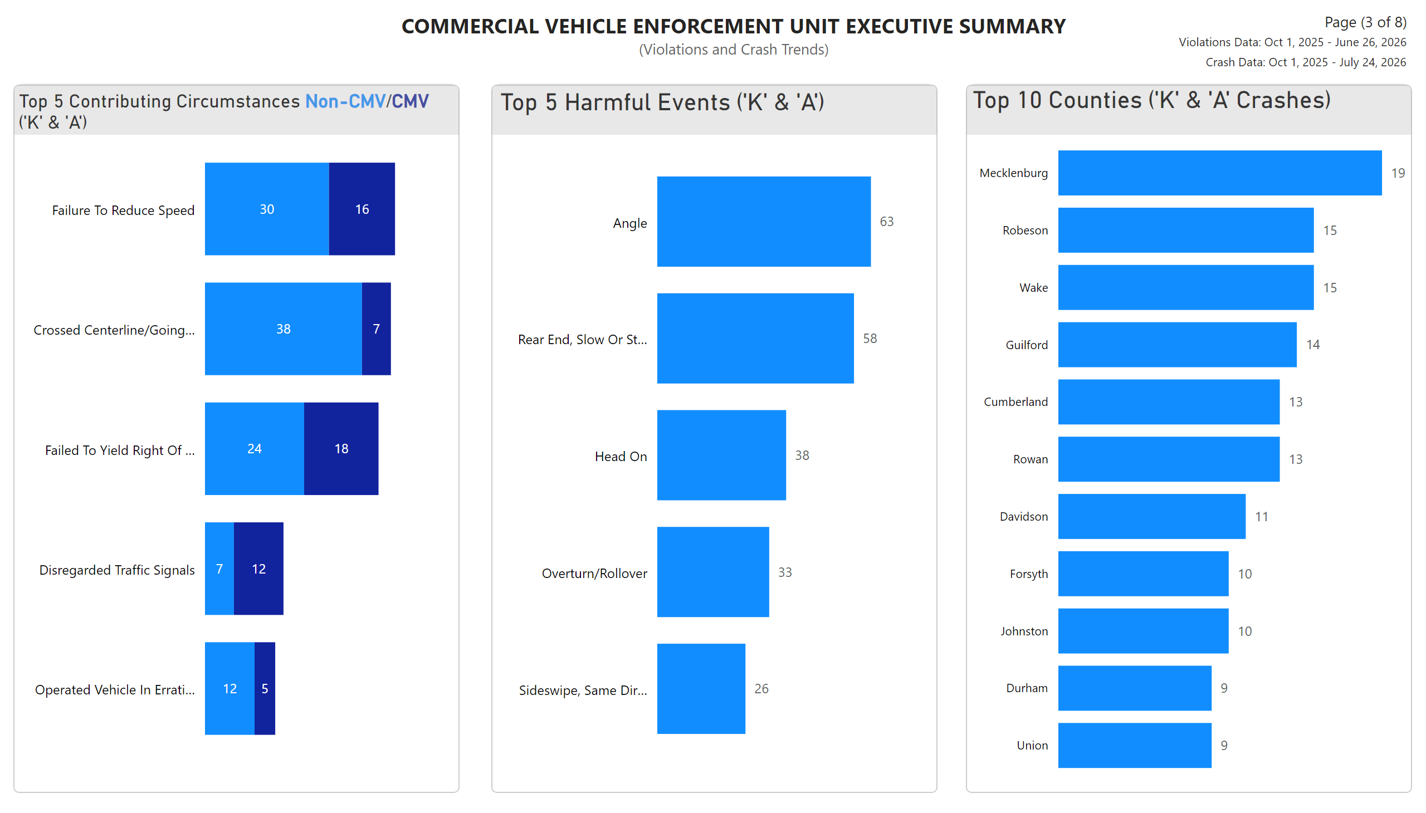
Page 3 - Crash
Notes:
data header
No alt text provided
textbox
No alt text provided
Top 5 Harmful Events ('K' & 'A')
No alt text provided
textbox
No alt text provided
textbox
No alt text provided
data header
No alt text provided
Top 5 Contributing Circumstances Non-CMV/CMV ('K' & 'A')
No alt text provided
Top 10 Counties ('K' & 'A' Crashes)
No alt text provided
data header
No alt text provided
textbox
No alt text provided

Slide 5
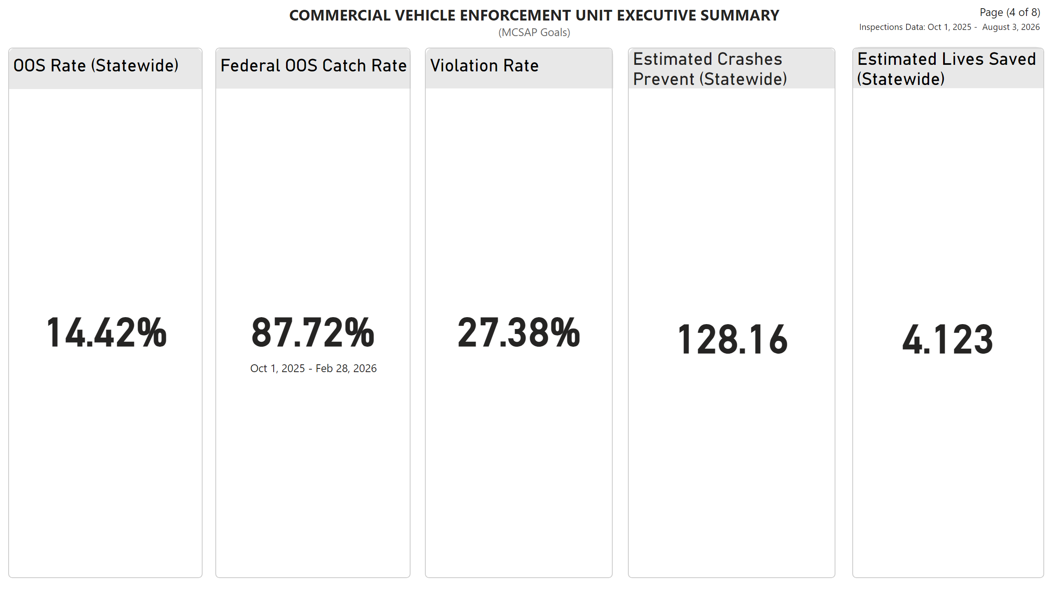
Page 4 - BANS
Notes:
Estimated Lives Saved (Statewide)
No alt text provided
Date box
No alt text provided
FedOOSctch
No alt text provided
Estimated Crashes Prevent (Statewide)
No alt text provided
VioRate
No alt text provided
estLiveSav
No alt text provided
OOSRate
No alt text provided
Federal OOS Catch Rate
No alt text provided
OOS Rate (Statewide)
No alt text provided
textbox
No alt text provided
estCrshpre
No alt text provided
Page Number
No alt text provided
Title
No alt text provided
Violation Rate
No alt text provided

Slide 6
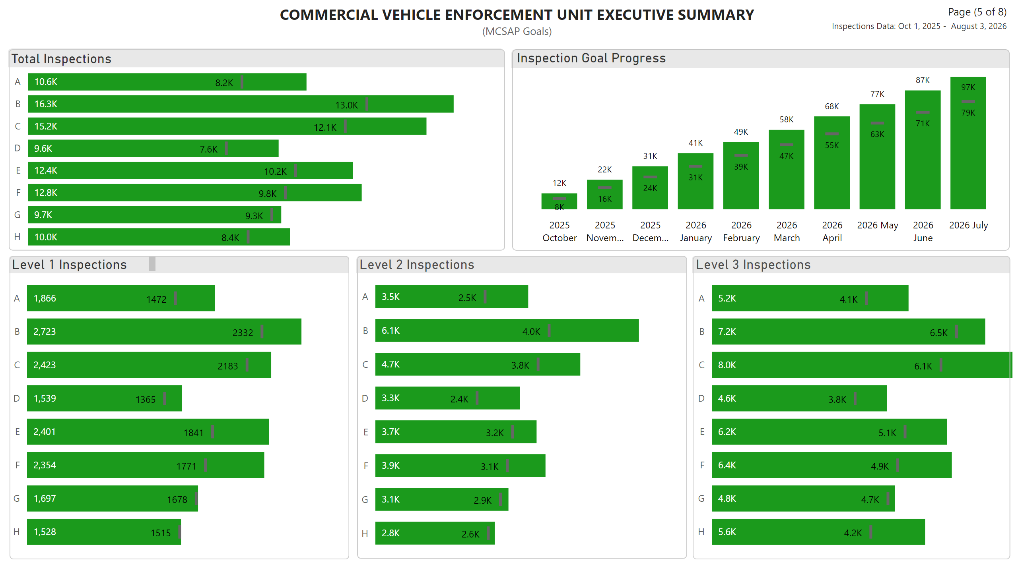
Page 5 - Inspections
Notes:
Slicer Border
No alt text provided
Title
No alt text provided
Inspection Goal Progress
No alt text provided
Slicer Border
No alt text provided
3 title
No alt text provided
Slicer Border
No alt text provided
tot insp title
No alt text provided
Level 3 Inspections
No alt text provided
Level 2 Inspections
No alt text provided
data header
No alt text provided
1 title
No alt text provided
data header
No alt text provided
Page Number
No alt text provided
Date box
No alt text provided
data header
No alt text provided
2 title
No alt text provided
Total Inspections
No alt text provided
data header
No alt text provided
Level 1 Inspections
No alt text provided
Slicer Border
No alt text provided
slicer
No alt text provided
estLiveSav
No alt text provided

Slide 7
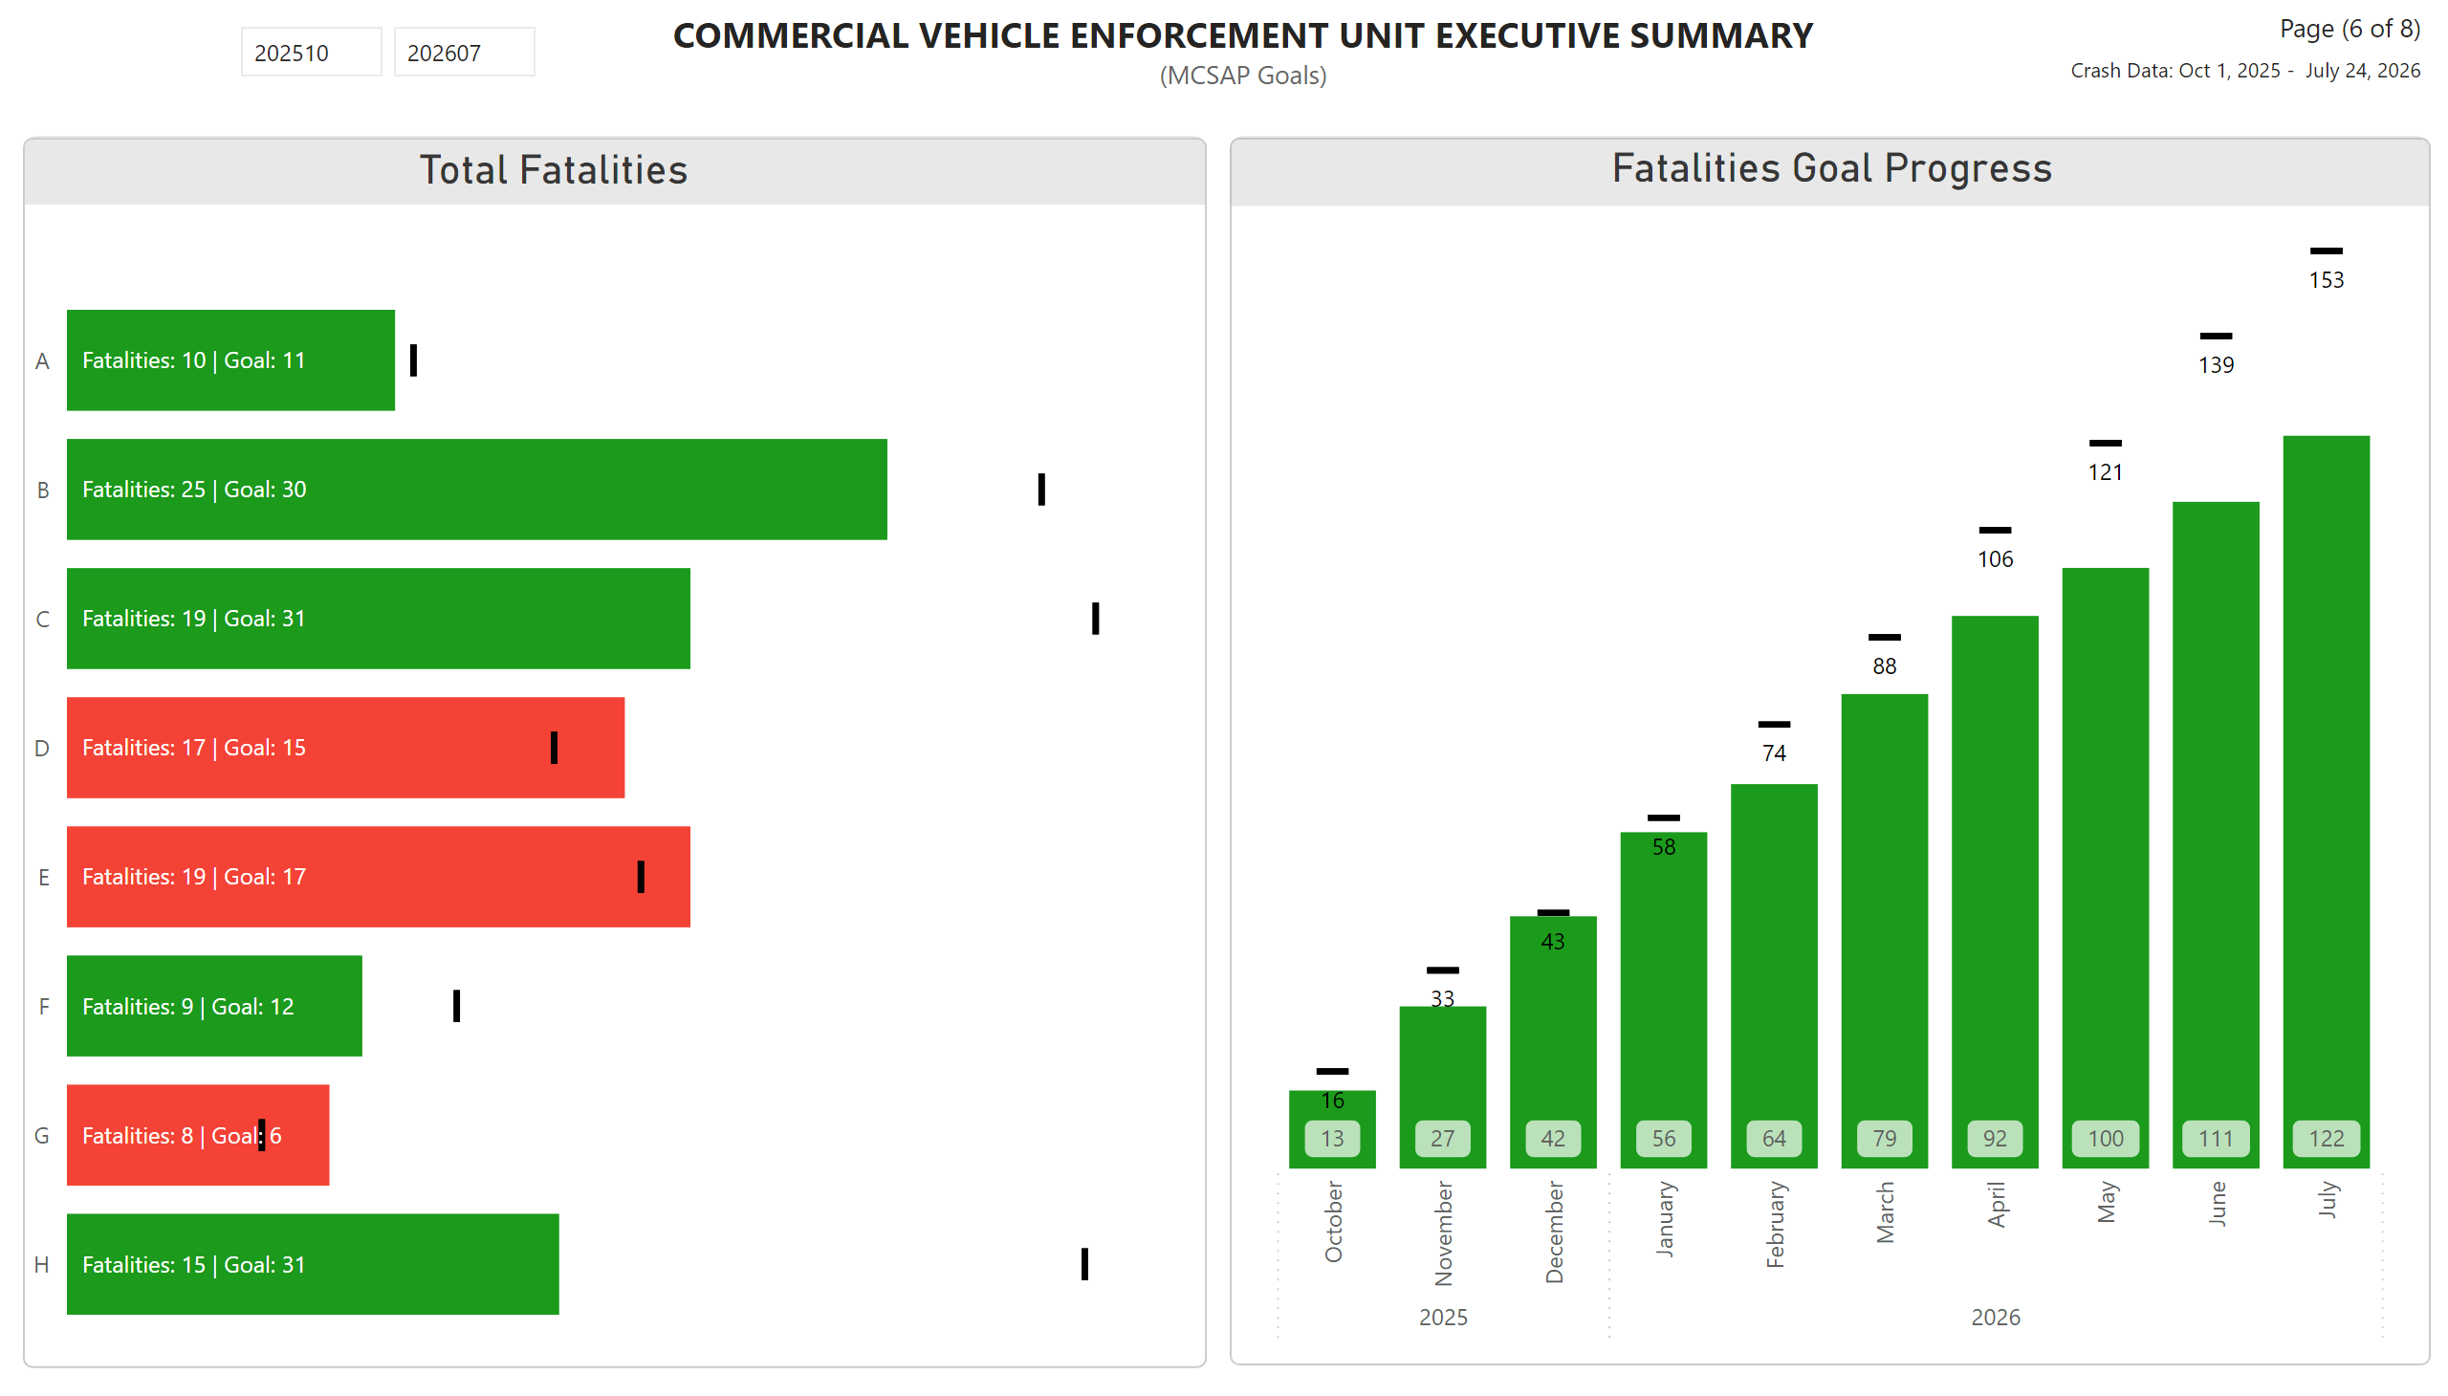
Page 6 - Fatalities
Notes:
Tot Fatalities
No alt text provided
data header
No alt text provided
Title
No alt text provided
Slicer Border
No alt text provided
Fatalities Goal Progress
No alt text provided
tot fat title
No alt text provided
slicer
No alt text provided
Date box
No alt text provided
estLiveSav
No alt text provided
Page Number
No alt text provided

Slide 8
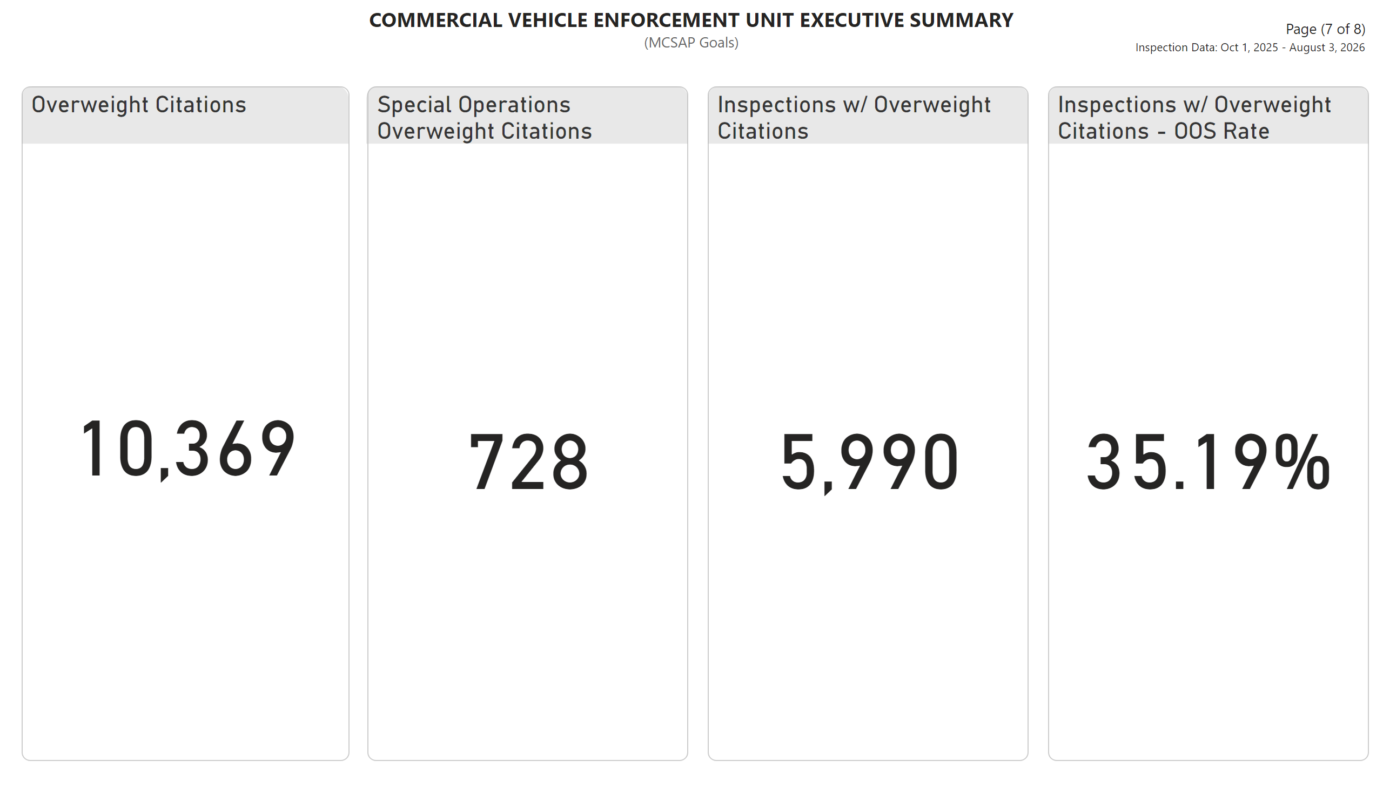
Page 7 - Stats
Notes:
Overweight Citations
No alt text provided
data header
No alt text provided
textbox
No alt text provided
Special Operations Overweight Citations
No alt text provided
Inspections w/ Overweight Citations - OOS Rate
No alt text provided
textbox
No alt text provided
Inspections w/ Overweight Citations
No alt text provided
data header
No alt text provided
data header
No alt text provided
textbox
No alt text provided
data header
No alt text provided

Slide 9
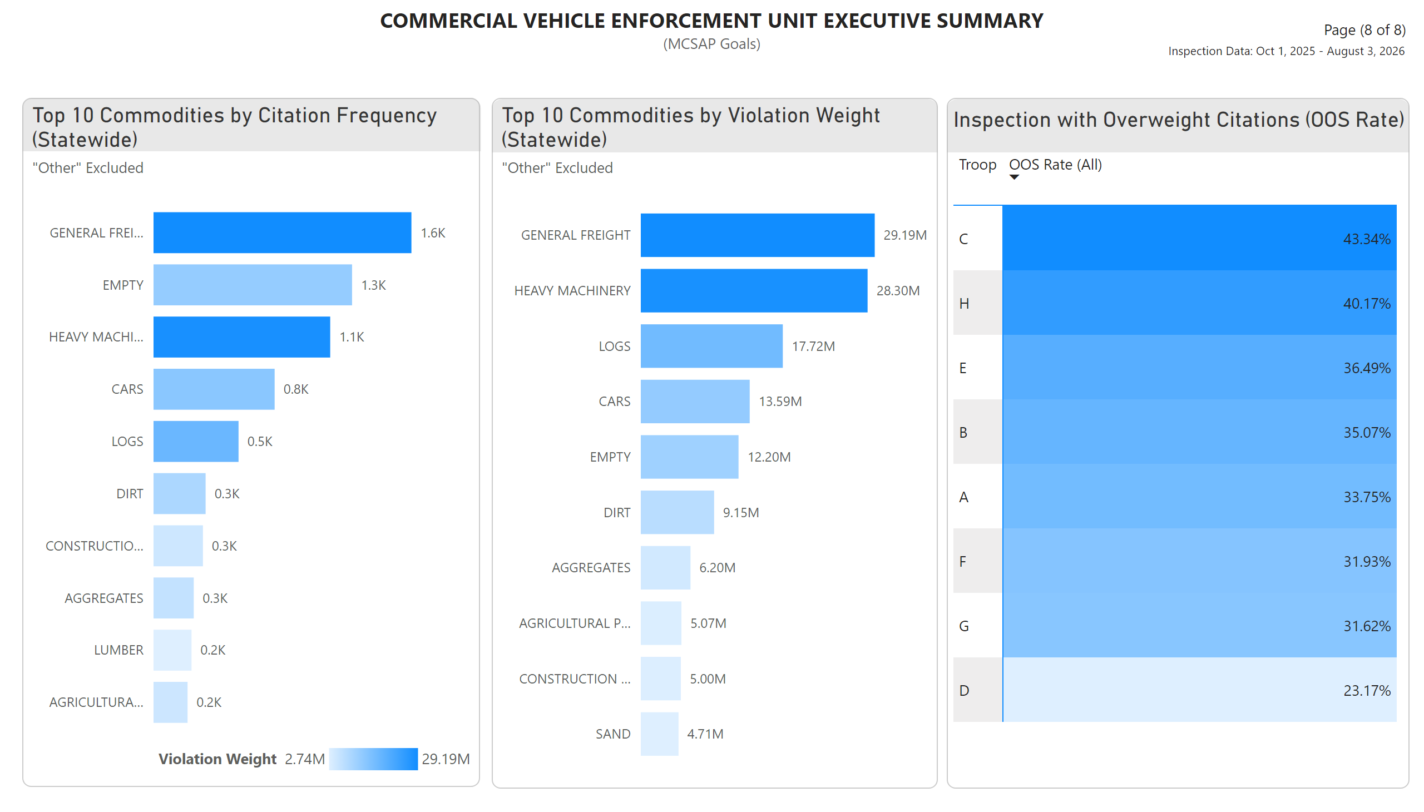
Page 8 - Top 10
Notes:
textbox
No alt text provided
textbox
No alt text provided
Top 10 Commodities by Violation Weight (Statewide)
No alt text provided
Top 10 Commodities by Citation Frequency (Statewide)
No alt text provided
data header
No alt text provided
data header
No alt text provided
data header
No alt text provided
Inspection with Overweight Citations (OOS Rate)
No alt text provided
textbox
No alt text provided

